Slide 1
MSI based Sequential Circuit

Slide 2
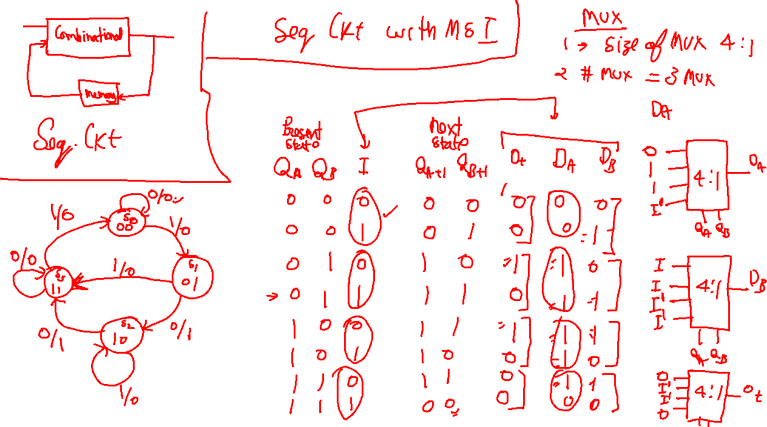

Slide 3
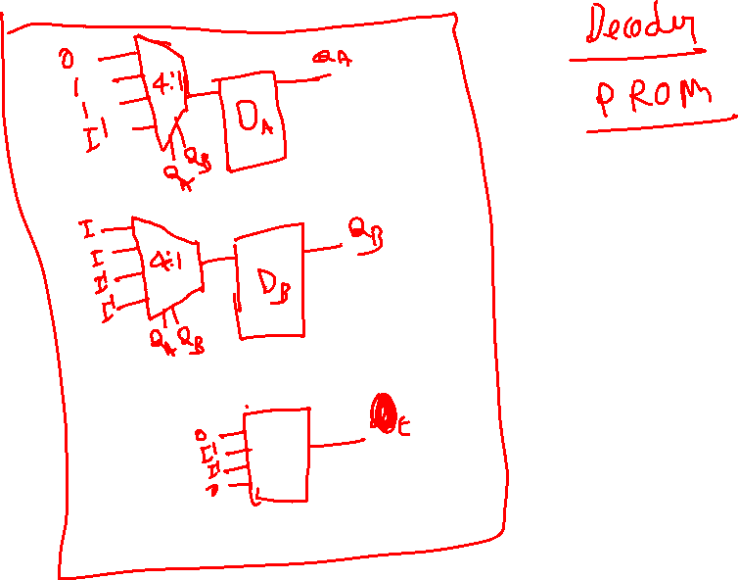

Slide 4



















